Slide 1

Understanding Write Off Account of Credit Card and its Impact

Slide 2

STUDENT INTRODUCTION
Peter Paul Kevin Tawalujan
Bootcamp Data Scientist Batch 17
2021 - Present
Bank ICBC Indonesia
Credit Policy Management
2018 - 2021
Bank Mizuho Indonesia
Credit Risk Controller
2017 - 2018
Bank MNC International
Credit Reviewer

Slide 3

BACKGROUND
Credit Risk
Operational Risk
Market Risk
Credit risk is the biggest risk for banks. It occurs when borrowers or counterparties fail to meet contractual obligations
Operational risk is the risk of loss due to errors, interruptions, or damages caused by people, systems, or processes
Market risk mostly occurs from a bank’s activities in capital markets. It is due to the unpredictability of equity markets, commodity prices, interest rates, and credit spreads

Slide 4
BACKGROUND
Credit Risk
Example of Bank Credit Risk is the Financial Crisis 2008, where
people began to default on their home mortgage loans.
In the wake of the 2008 Financial Crisis, International Accounting
Standards Board (IASB) published its new International Financing
Reporting Standard (IFRS) 9 Methodology, that implemented by
January 2018.
Pedoman Standar Akuntasi Keuangan (PSAK) 71, is an adaptation
from IFRS 9, to replace PSAK 55, and effective since January 2020.
Credit risk is the biggest risk for banks. It occurs when borrowers or counterparties fail to meet contractual obligations

Slide 5

BACKGROUND
PSAK 55
Impairment – Incurred Loss Model
Delays the recognition of credit losses until there is objective evidence of impairment.
Only past events and current conditions are considered when determining the amount of impairment (i.e., the effects of future credit loss events cannot be considered, even when they are expected).
PSAK 71
Impairment – Expected Credit Loss Model
Expected credit losses (ECLs) are recognized at each reporting period, even if no actual loss events have taken place.
In addition to past events and current conditions, reasonable and supportable forward-looking information that is available without undue cost or effort is considered in determining impairment.

Slide 6

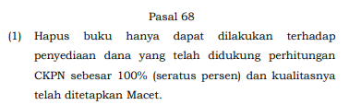
BACKGROUND
Relationship between write-off (hapus buku)
and impairment (CKPN):
Based on Otoritas Jasa Keuangan Regulation No 40/POJK.03/2019
regarding Bank’s Asset Quality Assessment chapter 68

Slide 7

OBJECTIVES
Identify, analyze, minimize, and forward-looking expected credit loss of write off credit card customer account

Slide 8
DATASET
Source:
https://www.kaggle.com/datasets/sakshigoyal7/credit-card-customers
The dataset consists of 10,000 customers mentioning their age, salary, marital status, credit card limit, credit card category, etc. There are nearly 18 features.
Originally the dataset focused on Churn credit card customer, however since the writer’s background is in Credit Risk, the writer will then focused the data on Write Off Customer.
Also the writer thought it is more useful to predict write off customer, since write off accounts are counted as loss for the Bank.
However, in the dataset, there is no column mentioning write off account customer.
Using writer’s experience in Banking, writer will assume that for every Attrited Customer (Churn Customer) that still have remaining revolving balance, is a write off customer.

Slide 9
DATASET
Columns | Explanation
CLIENTNUM | Client number. Unique identifier for the customer holding the account
Attrition_Flag | Internal event (customer activity) variable - if the account is closed then 1 else 0
Customer_Age | Demographic variable - Customer's Age in Years
Gender | Demographic variable - M=Male, F=Female
Dependent_count | Demographic variable - Number of dependents
Education_Level | Demographic variable - Educational Qualification of the account holder
Marital_Status | Demographic variable - Married, Single, Divorced, Unknown
Income_Category | Demographic variable - Annual Income Category of the account holder
Card_Category | Product Variable - Type of Card (Blue, Silver, Gold, Platinum)
Months_on_book | Period of relationship with bank
Columns | Explanation
Total_Relationship_Count | Total no. of products held by the customer
Months_Inactive_12_mon | No. of months inactive in the last 12 months
Contacts_Count_12_mon | No. of Contacts in the last 12 months
Credit_Limit | Credit Limit on the Credit Card
Total_Revolving_Bal | Total Revolving Balance on the Credit Card
Avg_Open_To_Buy | Open to Buy Credit Line (Average of last 12 months)
Total_Amt_Chng_Q4_Q1 | Change in Transaction Amount (Q4 over Q1)
Total_Trans_Amt | Total Transaction Amount (Last 12 months
Total_Trans_Ct | Total Transaction Count (Last 12 months)
Total_Ct_Chng_Q4_ | Change in Transaction Count (Q4 over Q1)
Avg_Utilization_Ratio | Average Card Utilization Ratio

Slide 10
DATA CLEANING
Remove unique id (Clientnum Column) and also Naïve Bayes Classifier Columns
No Missing Values and Duplicate Values found
All data’s dtype are already inline
Identifying the Write-Off Customers

Slide 11

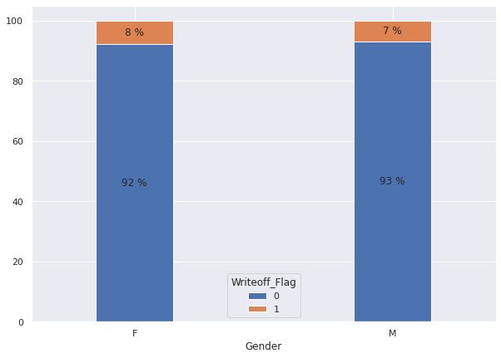
EXPLORATORY DATA ANALYSIS
Characteristics of Write Off Customers
By small percentage, female has more write off customers than male

Slide 12
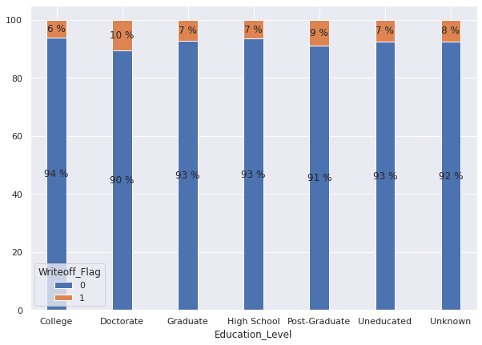
EXPLORATORY DATA ANALYSIS
Characteristics of Write Off Customers
By percentage, customer with Doctorate Education Level, has the most write off account

Slide 13
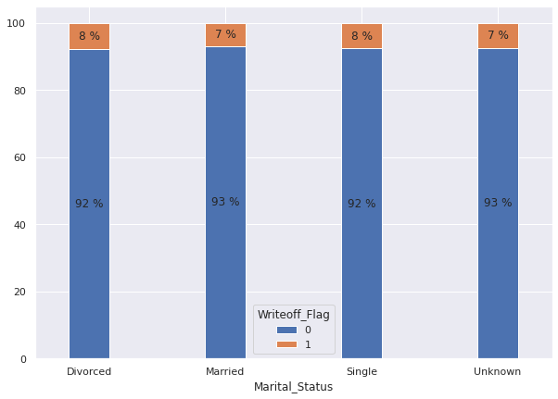
EXPLORATORY DATA ANALYSIS
Characteristics of Write Off Customers
By small percentage, divorced and single customers have more write off account than married customers

Slide 14
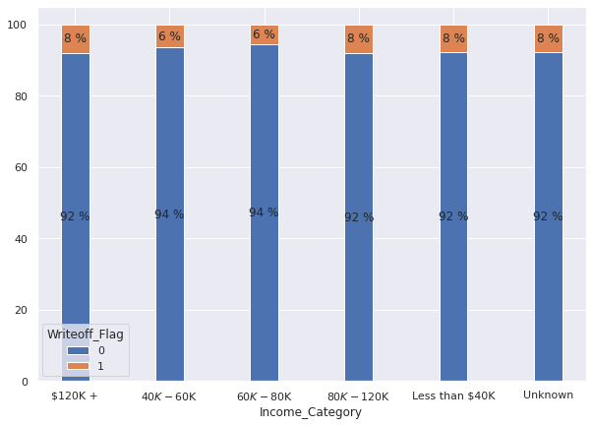
EXPLORATORY DATA ANALYSIS
Characteristics of Write Off Customers
By small percentage, middle income category, both 40k-60k and 60k-80k, has smaller percentage of write off account than other income category

Slide 15
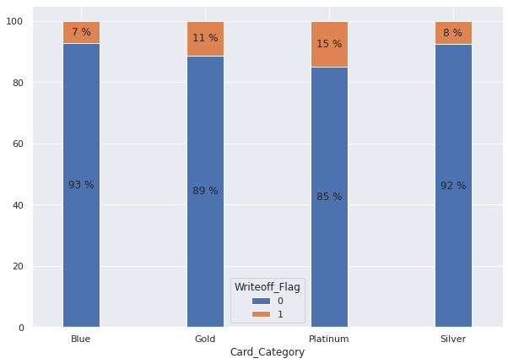
EXPLORATORY DATA ANALYSIS
Characteristics of Write Off Customers
By percentage, Platinum card holders have more write off account than other card category

Slide 16

MODELING
Model | F1 Score
KNN | 0.59
Logistic Regression | 0.92
Decision Tree | 1.00
Random Forest | 1.00

Slide 17

CONCLUSION
With EDA, Bank can adjust their credit card acceptance guideline, hence the Bank can minimize their write off accounts.
With Modeling, Bank can calculate the expected credit loss, as now Bank should use forward-looking method of expected credit loss.

Slide 18
Thank You

